Slide 1

Welcome to the World of
Learning !

Slide 2
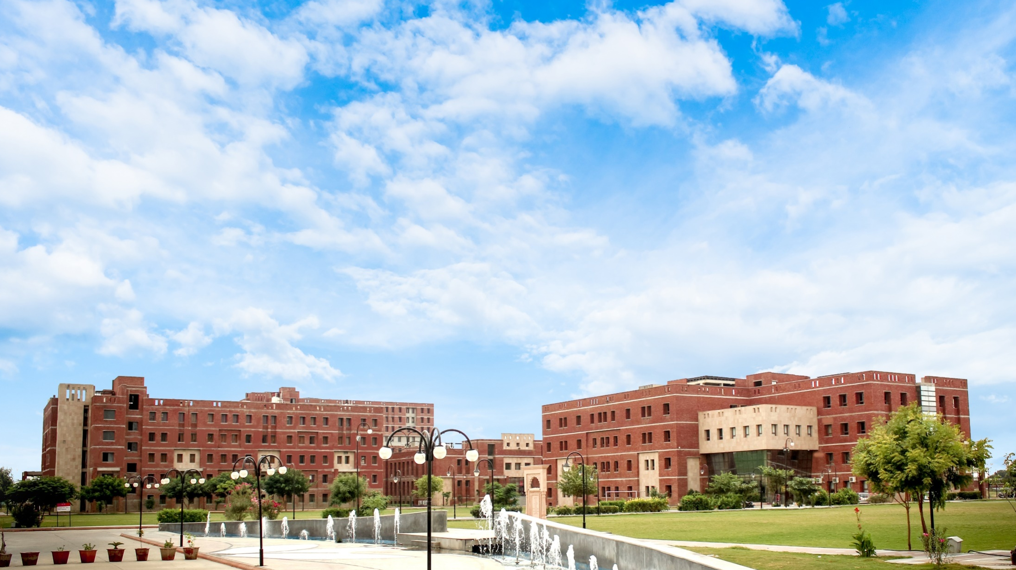

Internship Viva Presentation 2024
Topic “….. …”
Submitted By:
Name of Company Name: …. Regn. No.
Name of Faculty Internship Guide Name of Industry Guide
ABCD… ABCD………………
.
LOGO of Company

Slide 3
INTERNSHIP VIVA 2024
CONTENTS
Introduction
Internship Completion certificate
Internship Organization Overview
Internship Objectives
Roles and Responsibilities
Projects Undertaken
Methodology
Outcome of Assignment/Project ( Screenshots etc.)
Key Learning
Contribution to the Organization
Conclusion and Future Plans
Acknowledgments
Collage ( of On site Photographs with Guide and Co. colleagues in office)
Appendices ( Sample Code/Forms/Data sheets etc.)
Q&A

Slide 4
Title Slide
Title of the Presentation
Student's Name
Internship Position
Company Name
Internship Duration
-Date of Presentation

Slide 5
Introduction
Brief Introduction of Yourself
- Academic background
- Major achievements
-Overview of the Presentation
- Outline the main sections
Internship Organization Overview
-Company Introduction
- Name and location
- Brief history
- Core business areas
- Organizational Structure
- Key departments
- Your department’s place in the organization

Slide 6
Internship Objectives
- Objectives of the Internship
- Personal learning goals
- Goals set by the company
Roles and Responsibilities
- Your Role
- Job title
- Description of daily tasks
- Responsibilities
- Key responsibilities
- Any special projects

Slide 7
Projects Undertaken
- Major Projects
- Title of each project
- Brief description
- Your role and contributions
- Skills Acquired
- Technical skills
- Soft skills
Methodology
- Approach
- Steps taken to complete tasks/projects
- Tools and technologies used
- Challenges
- Key challenges faced
- How you overcame them

Slide 8
Key Learning
- Technical Learning
- Specific technical skills or knowledge gained
- Professional Growth
- Teamwork and collaboration
- Time management
- Communication skills
Contribution to the Organization
- Value Added
- Specific contributions made to the projects or organization
- Feedback
- Feedback received from supervisors or team members

Slide 9
Conclusion
- Summary of Experience
- Recap of key points
Future Plans
- How this internship has influenced your career goals
Recommendation to Co. about the Project/Assignment
Collage ( of On site Photographs with Guide and Co. colleagues in office)
Acknowledgments
- Gratitude
- Thanking mentors, supervisors, and team members
- Special Mentions
- Any particular individuals or groups who were instrumental in your internship
Q&A
- Open the floor for questions from the audience

